Slide 1
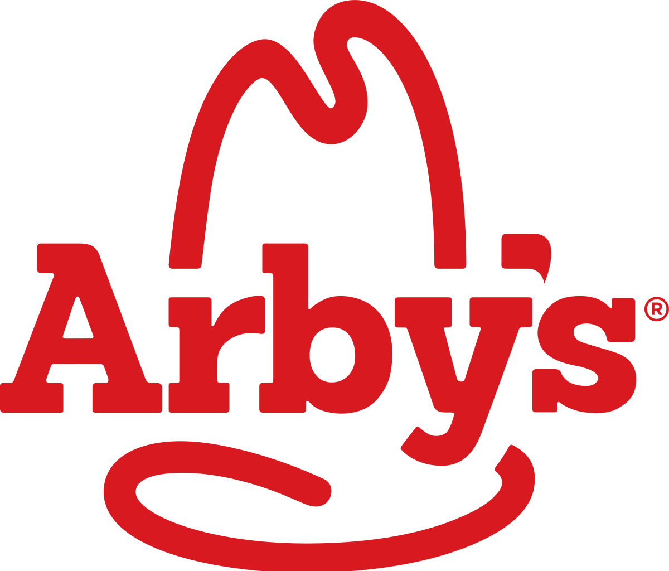
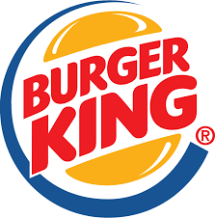






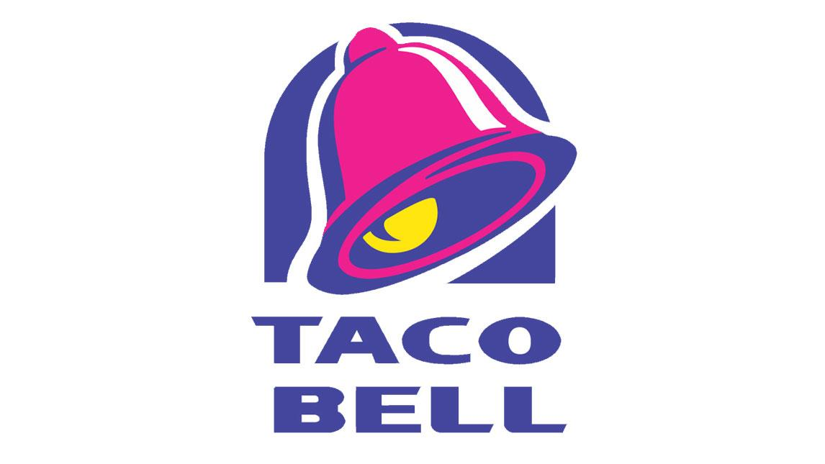
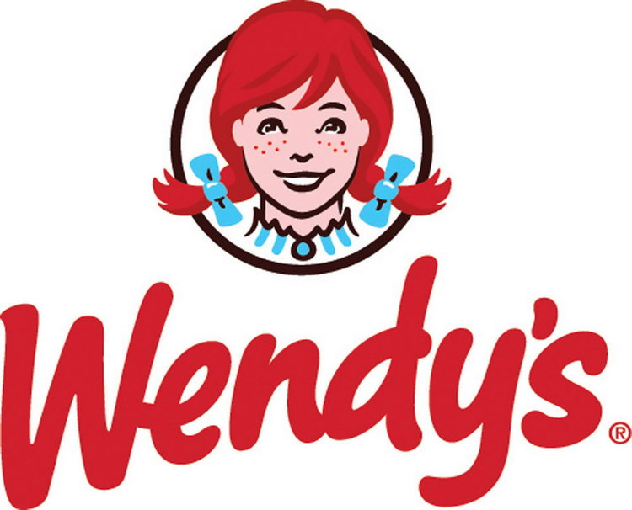
EDA of Fast Food Restaurant

Slide 2
Introduction
In this project I will analyse Fast Food Restaurant data set across US
Research Questions (Q):
Spread of Restaurant across whole US?
Top 10 Restaurant?
Top 10 cities?
what are the contribution percentage of top 10 Restaurant?
What are the contribution percentage of top 10 Cities?
Spread of other restaurant across US?
Research Hypothesis/Conclusion :
Mcdonalds is the highest available Restaurant.
Cincinnati is the City with highest number of restaurant.
Eastern US has more number of restaurant.
California has the highest number of restaurant in Western US.

Slide 3
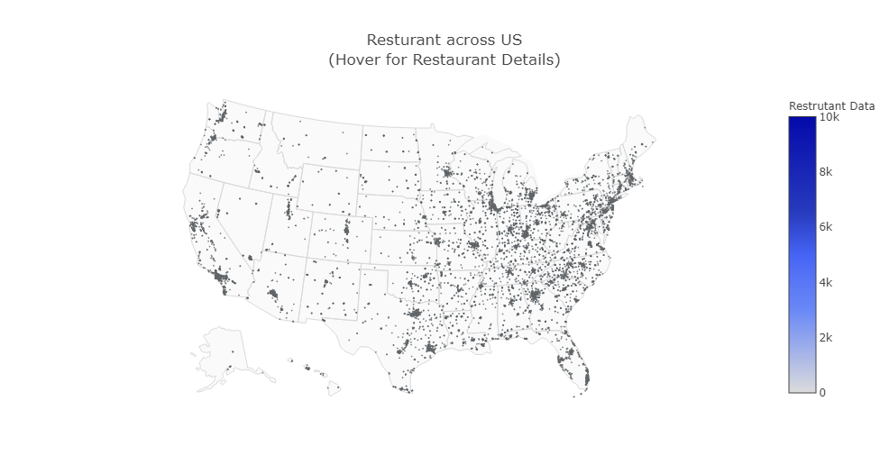
Restaurant Distribution Across US

Slide 4
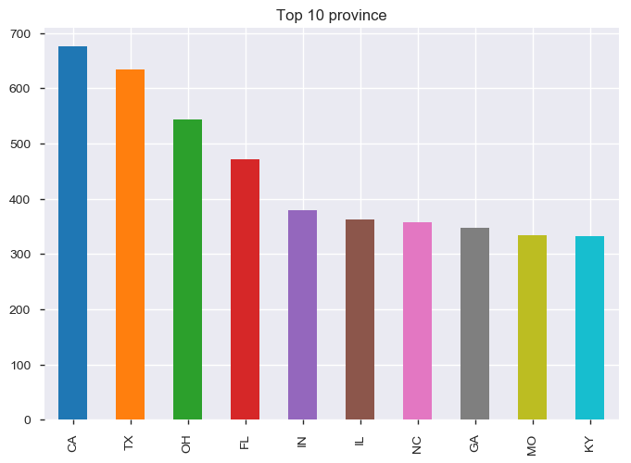
Top 10 Provinces in US

Slide 5
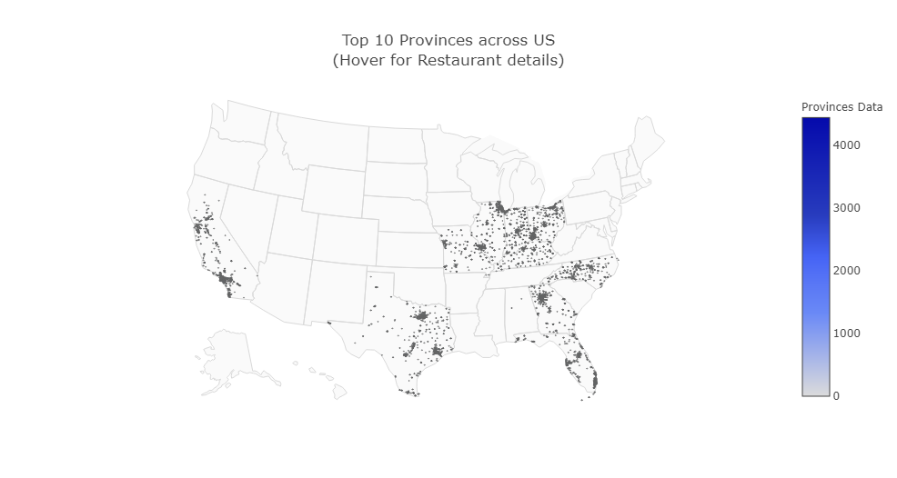
Restaurants across top 10 Provinces

Slide 6
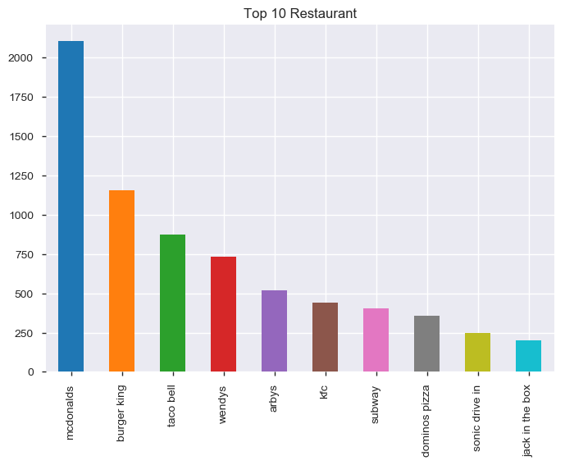
Top 10 Restaurants across US

Slide 7
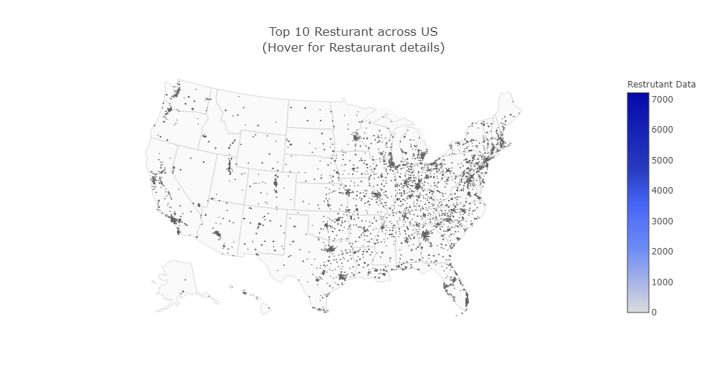
Top 10 Restaurant Distribution across US

Slide 8
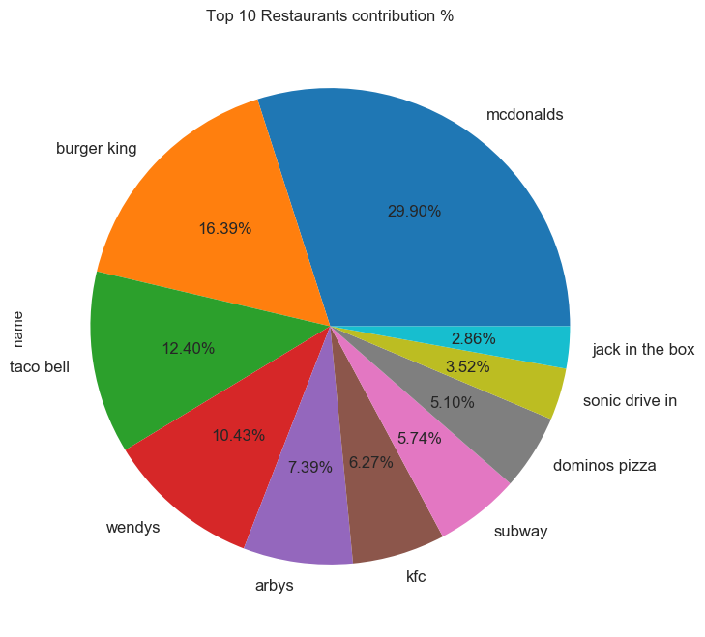
Top 10 Restaurants Distribution

Slide 9
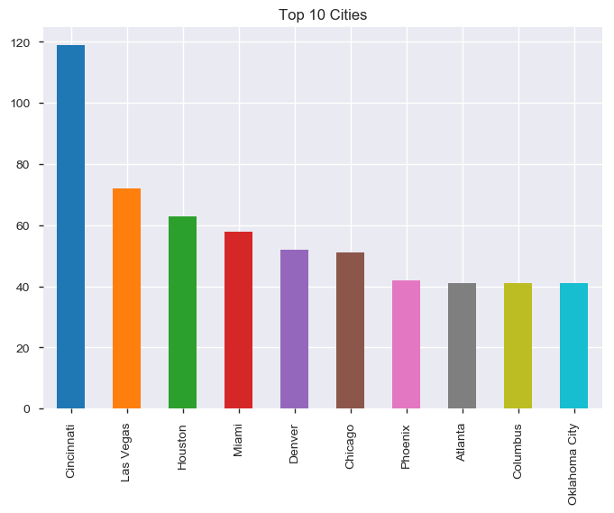
Top 10 Cities in US

Slide 10
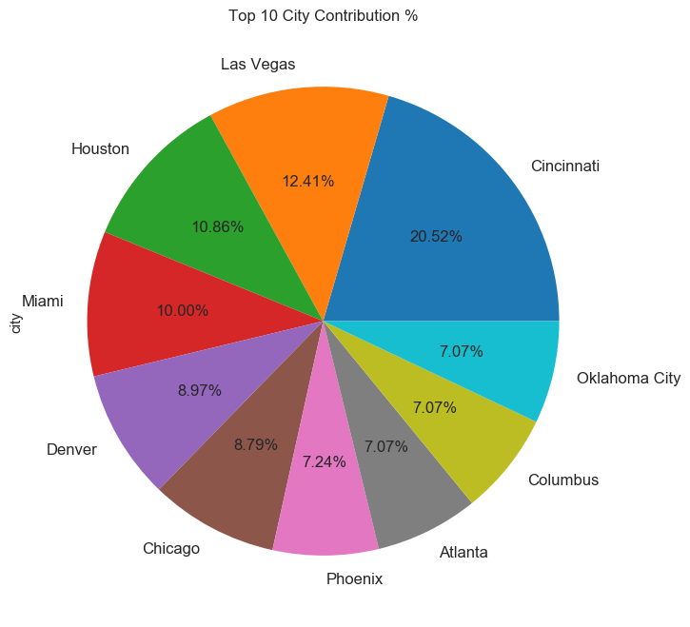
Top 10 Cities Restaurant Distribution

Slide 11
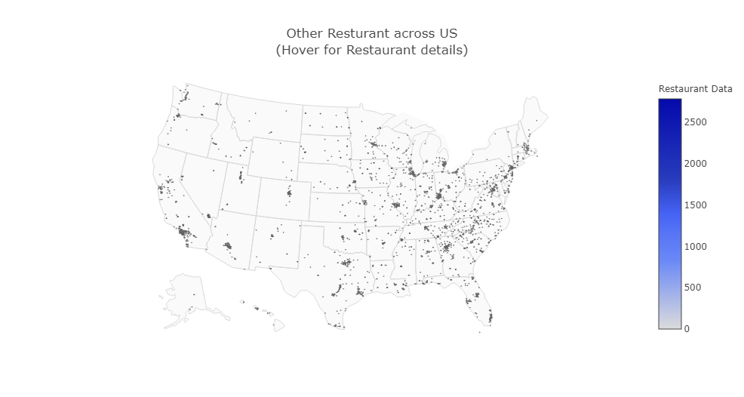
Other Restaurants Distribution across US

Slide 12
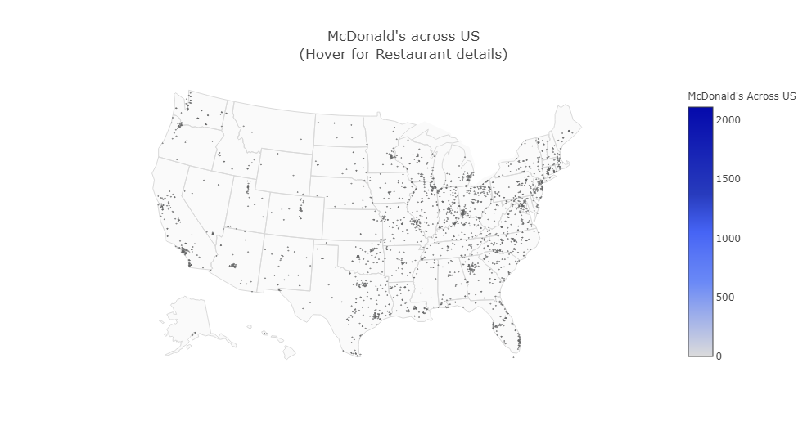
McDonald’s Distribution across US

Slide 13
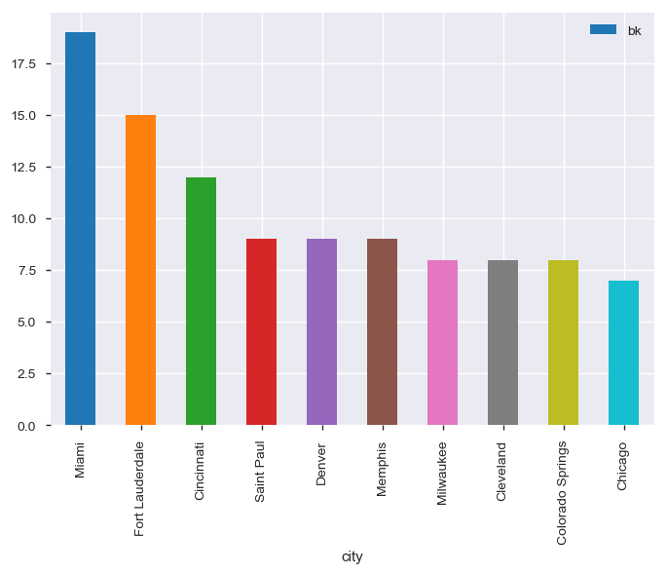
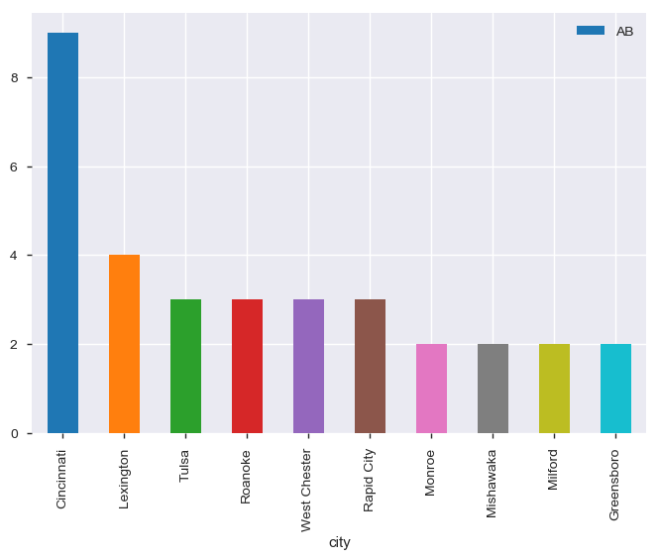
Top 10 Restaurants presence over US. Legends:- BK= Burger King and AB = Arby’s
P.T.O

Slide 14
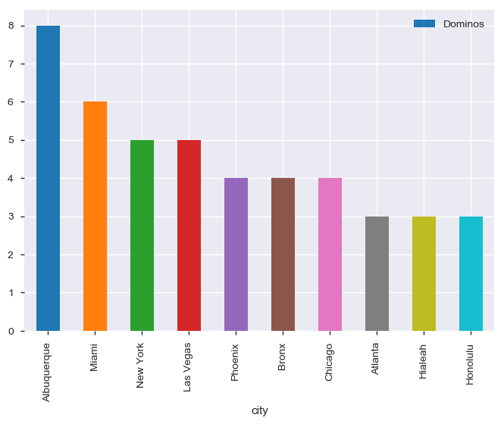
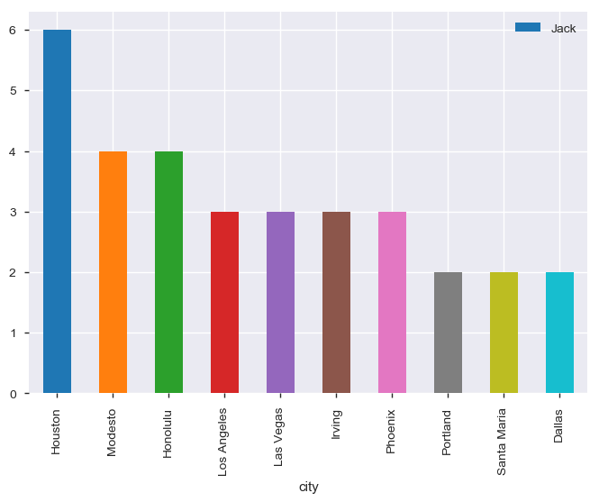
Legends:- Dominos=Dominos Pizza and Jack= Jack in the Box
P.T.O

Slide 15
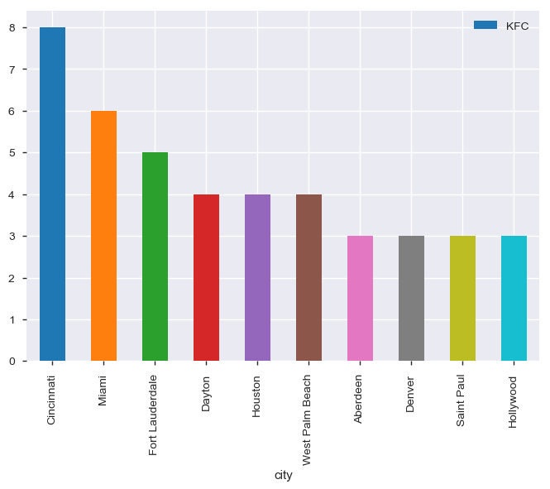
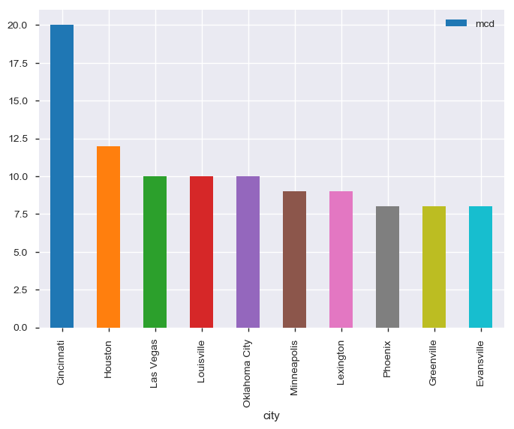
Legends:- KFC=KFC and mcd= McDonald’s
P.T.O

Slide 16
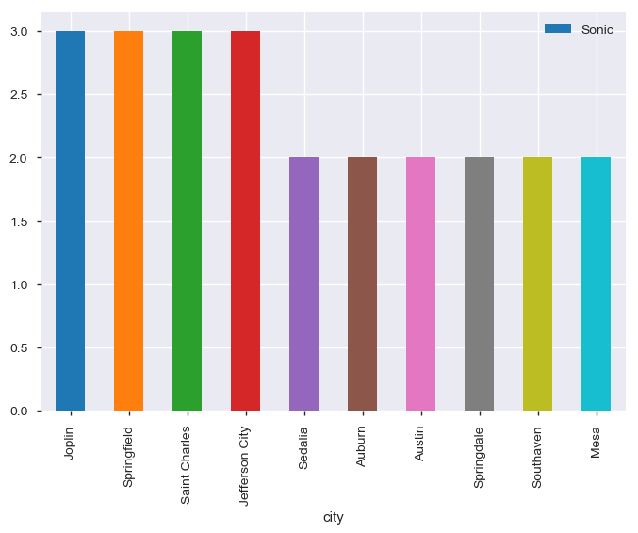
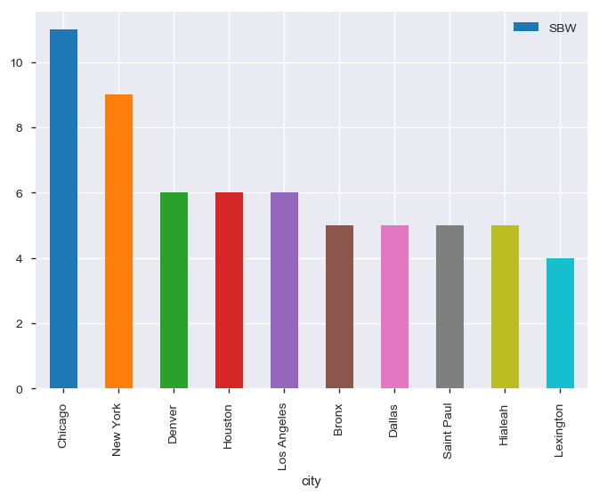
Legends:- Sonic= Sonic’s Drive In and SBW= SUBWAY
P.T.O

Slide 17
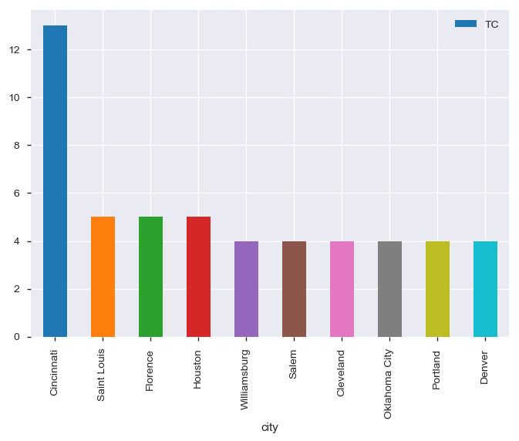
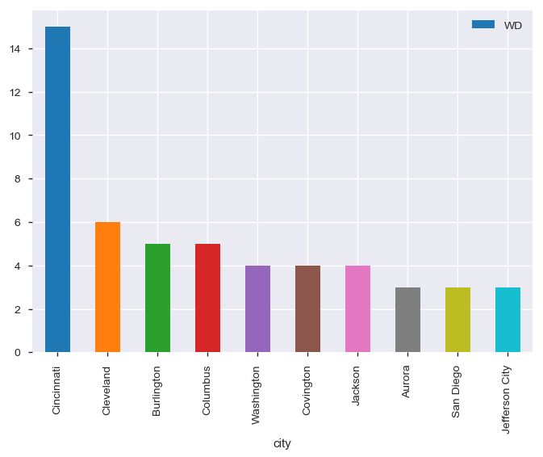
Legends:- TC= Taco Bell and WD= Wendy’s

Slide 18
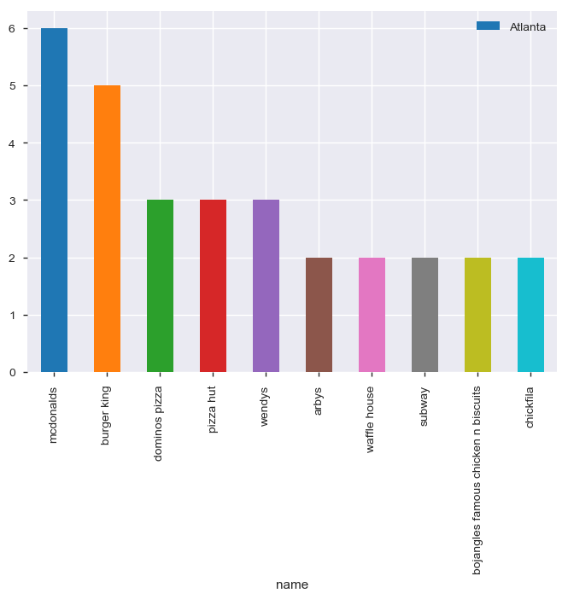
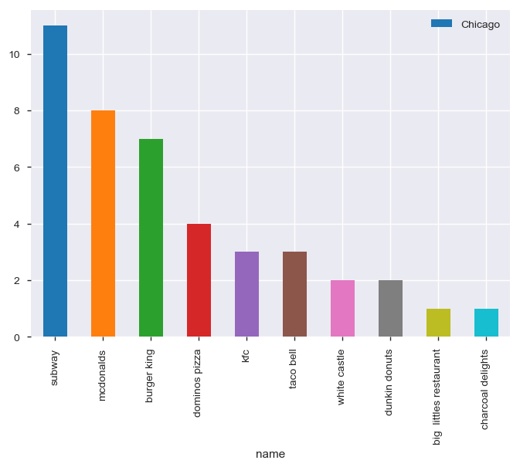
Restaurants in Top 10 Cities.
P.T.o

Slide 19
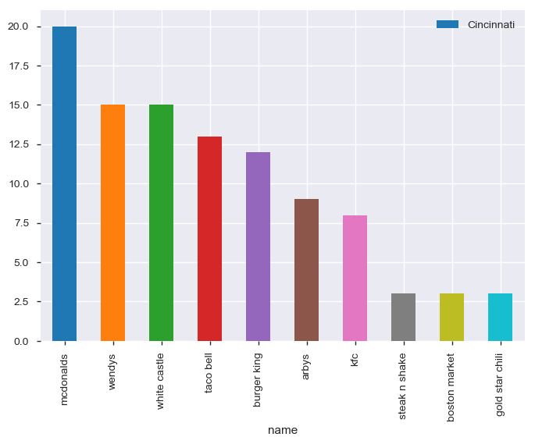
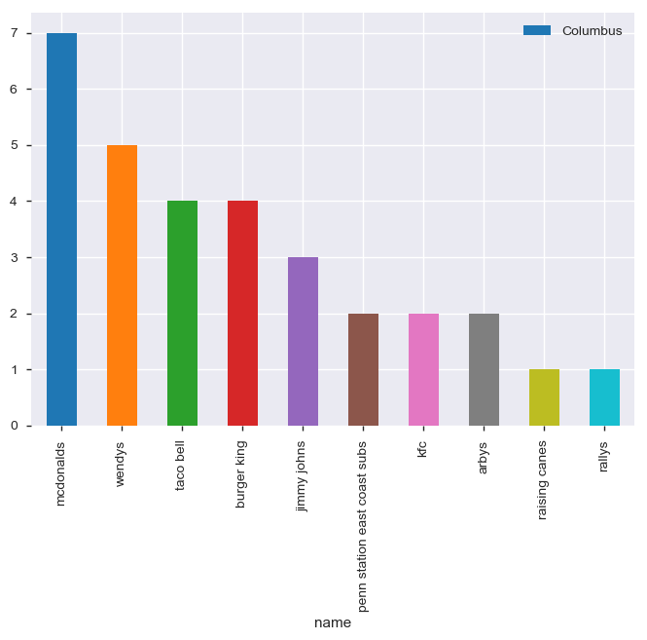
P.T.O

Slide 20
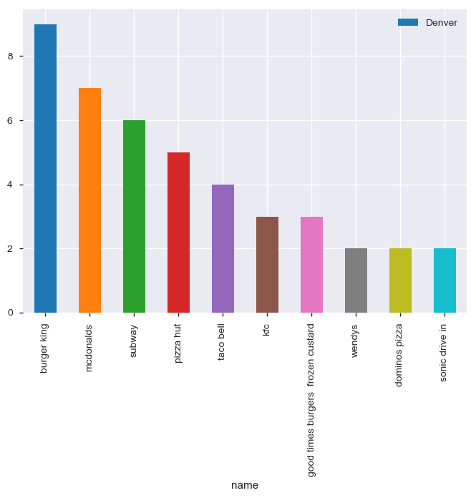
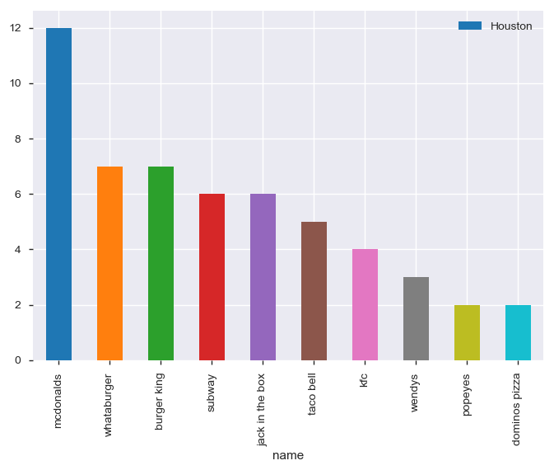
P.T.O

Slide 21
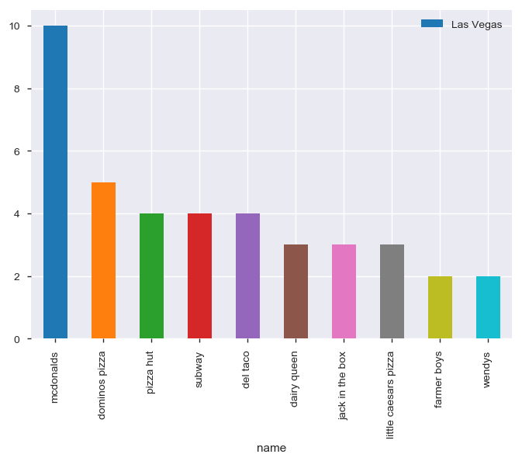
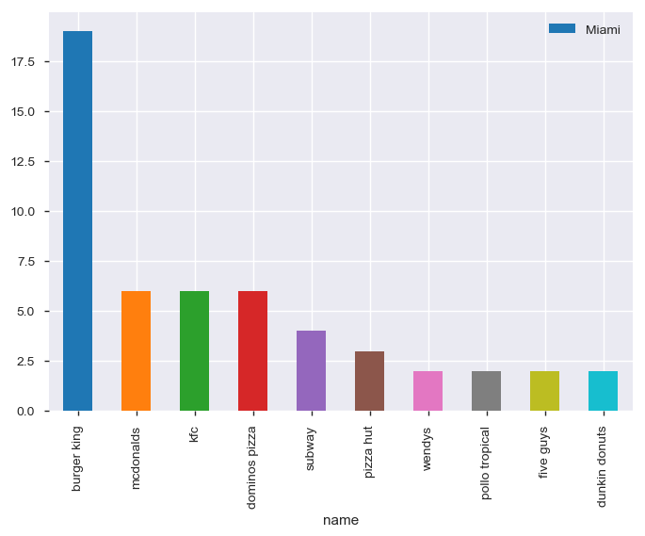
P.T.O

Slide 22
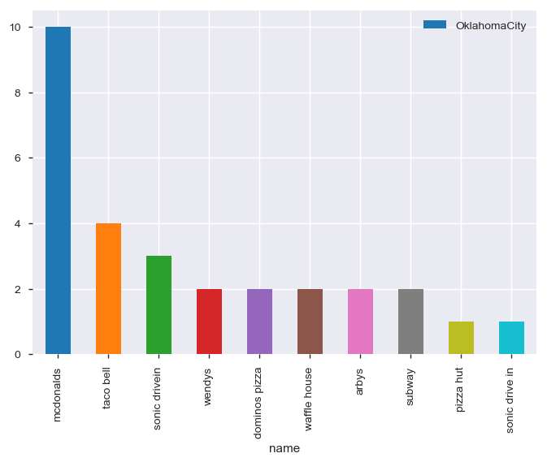
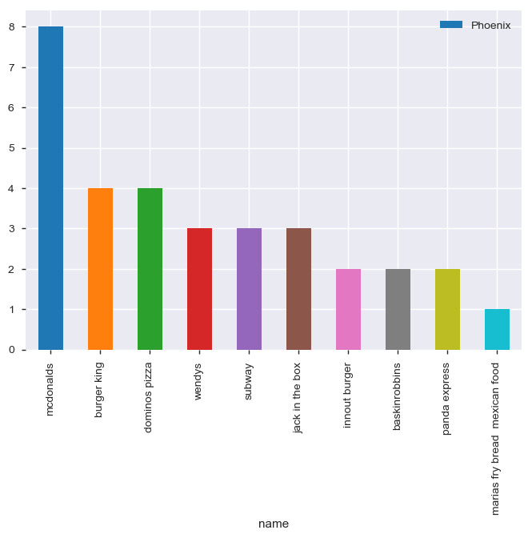
P.T.O

Slide 23
Conclusion
Mcdonalds is the highest available Restaurant and has 29.90% contribution in top 10 Restaurant.
Cincinnati is the City with highest number of restaurant with 20.52% of total restaurants.
Eastern US has more number of restaurant.
California has the highest number of restaurant in Western US.
Top 10 Cities also have restaurants which doesn't categorise in top 10 Restaurant List.
It's clear that people of US likes food from McDonald's due to ease of availability and distribution.

